Slide 1
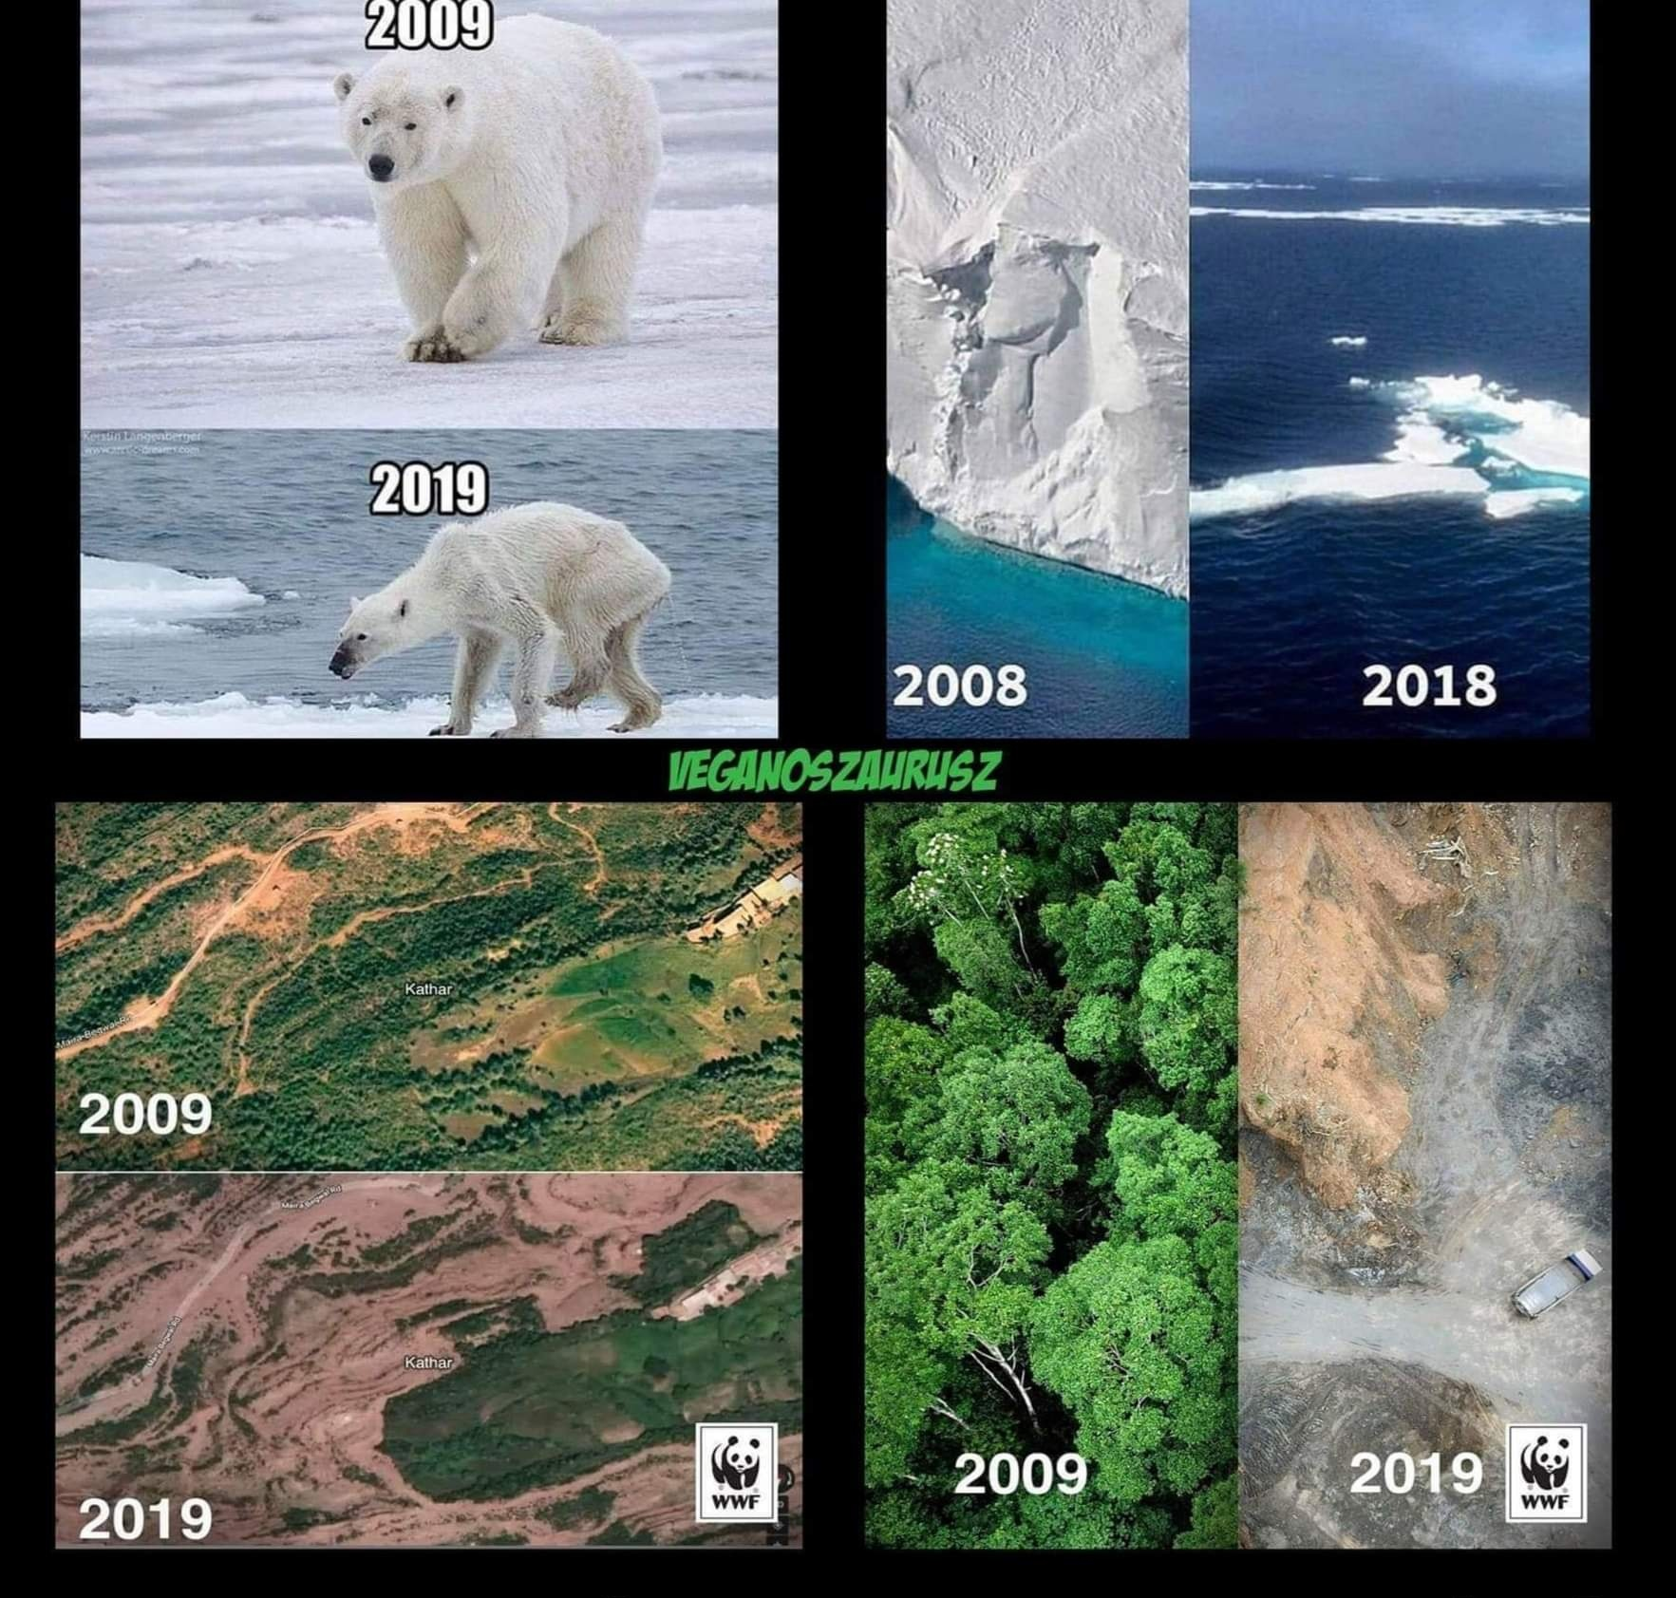
CLIMATE CHANGE
Causes, effects & solutions

Slide 2
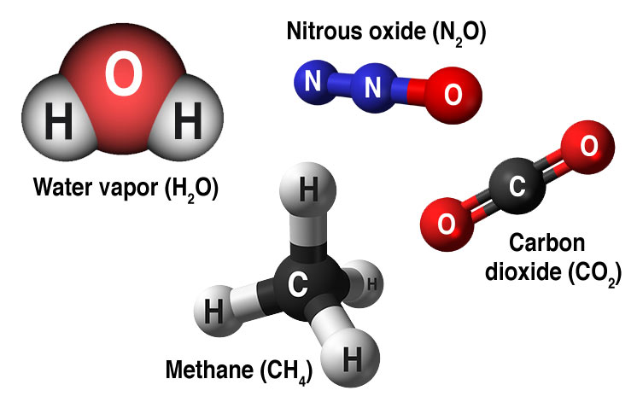
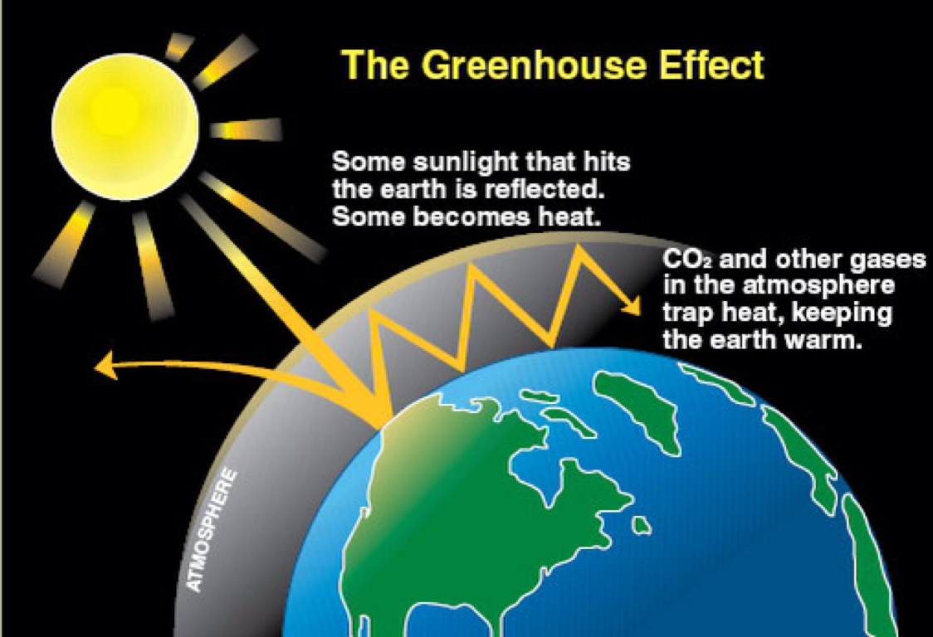
Causes of global warming
Greenhouse effect – due to human activity
People
burn fossil fuels for centuries (coal, gas, oil)
cut down & burn trees to clear the land for farming to feed 8 billion people (or more)
pollute rivers, lakes, air and everything around them
Greenhouse gases

Slide 3
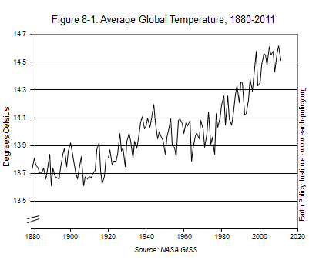
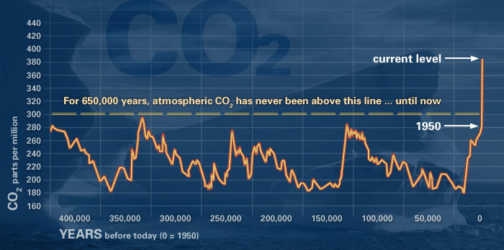
Effects of global warming
Temperatures rise
Glaciers, ice sheets melt sea levels rise people living in coastal areas have to move
More extreme weather conditions (intense storms, hurricanes, floods, droughts)
Species die out alarmingly quickly
Water supplies shrink
Asthma, heart disease, lung cancer (due to smog)
rising CO₂ emission
Rising global temperature

Slide 4
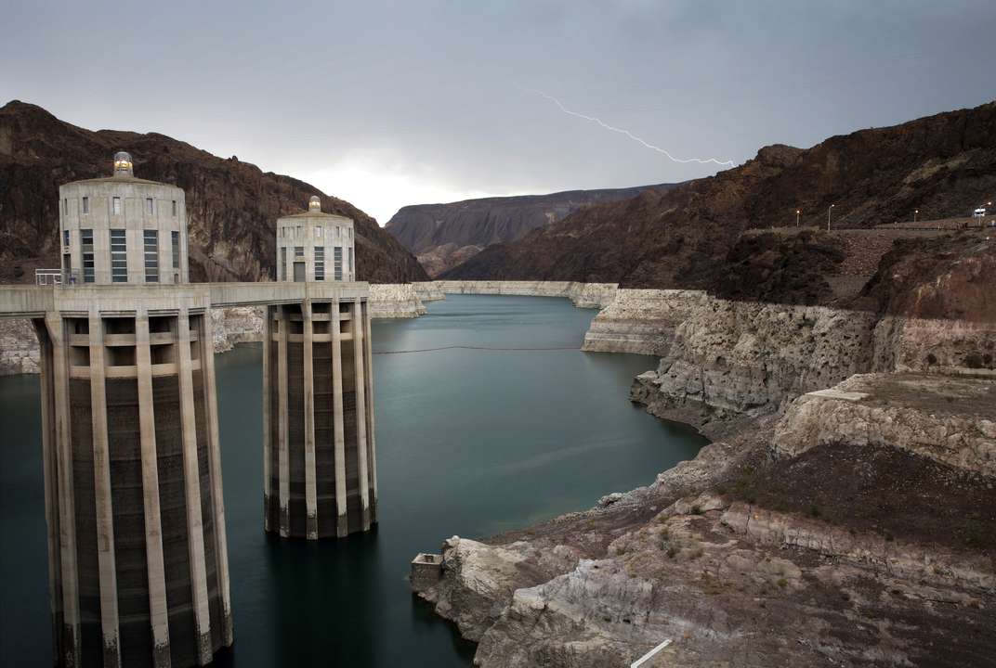
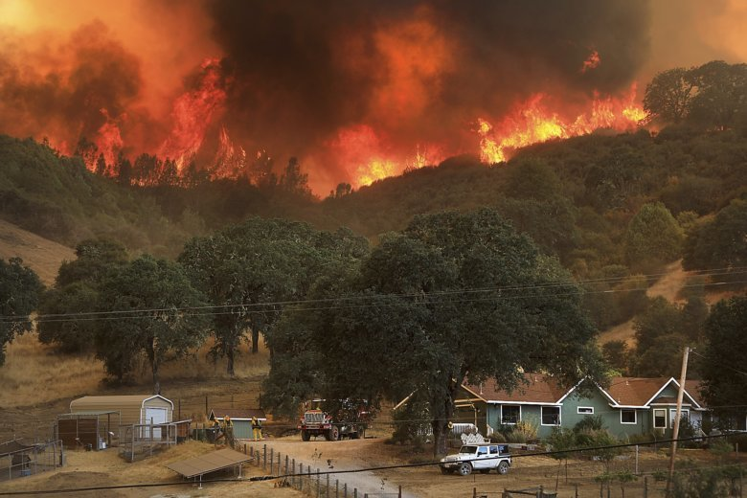
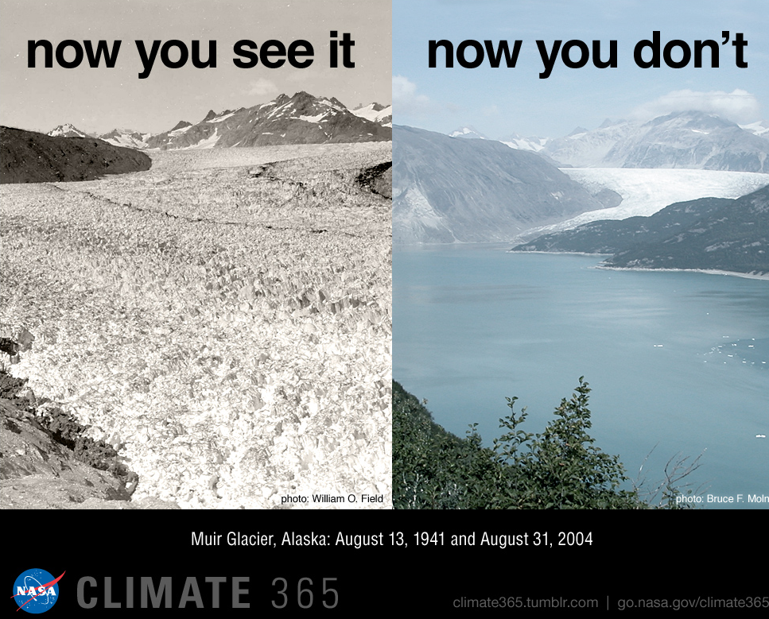
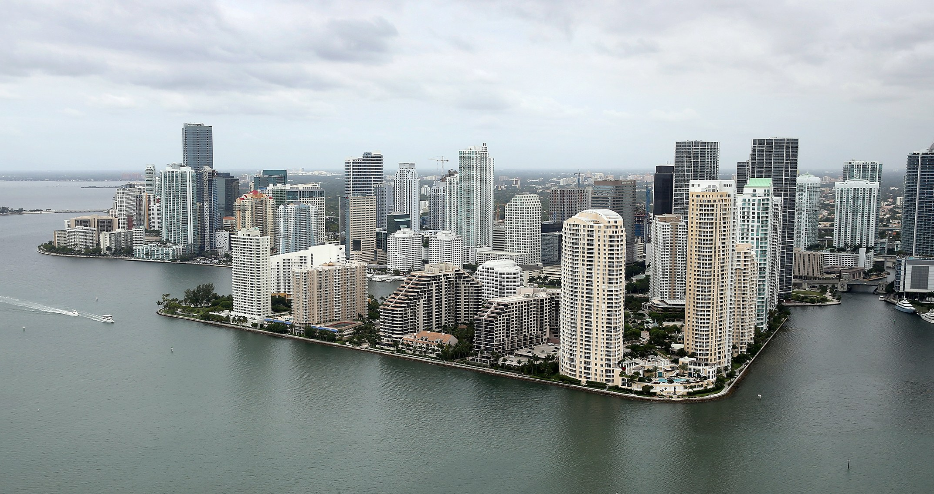
Evidence
coral reefs dying
Colorado River drying up
Wildfire in California 2018
Glaciers melting
Cities like Miami can be under water soon

Slide 5
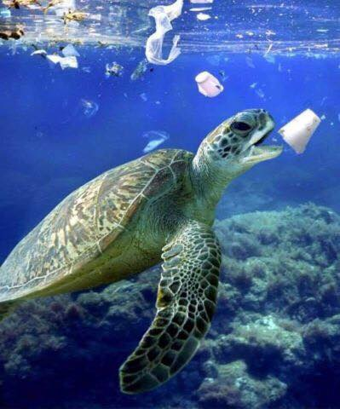
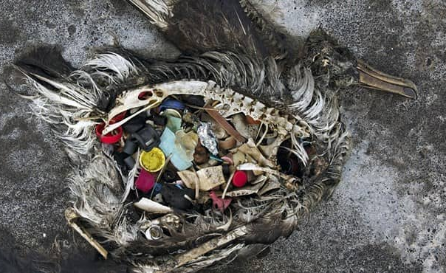
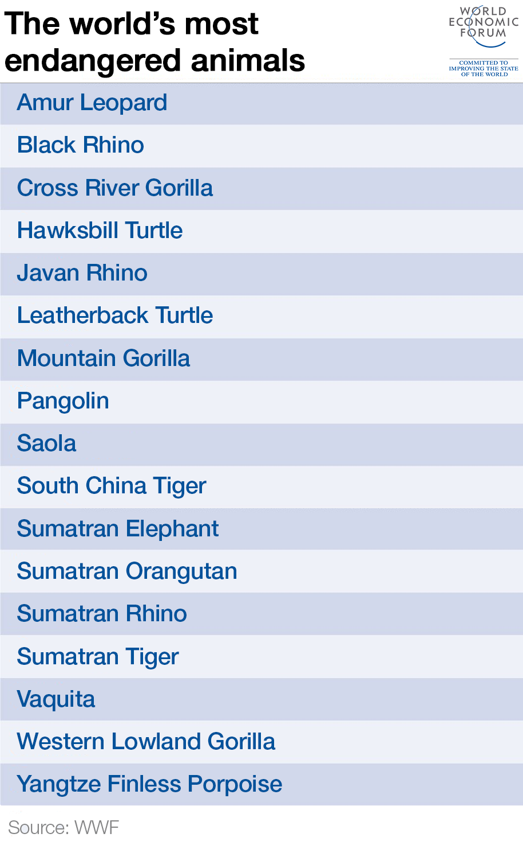
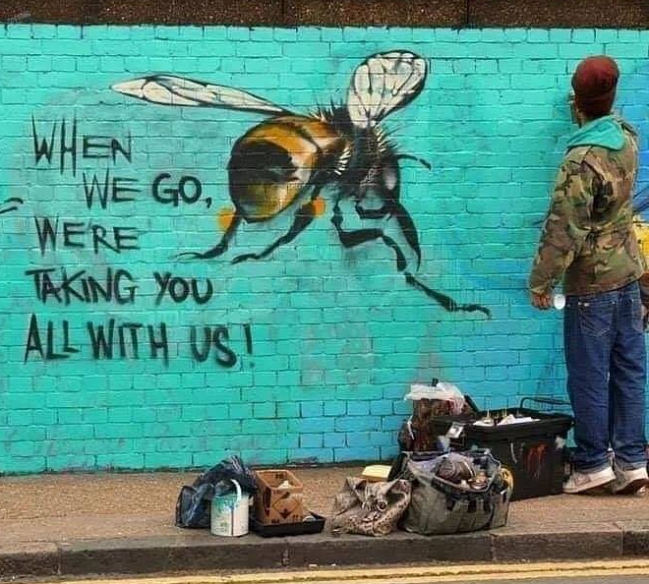

Slide 6
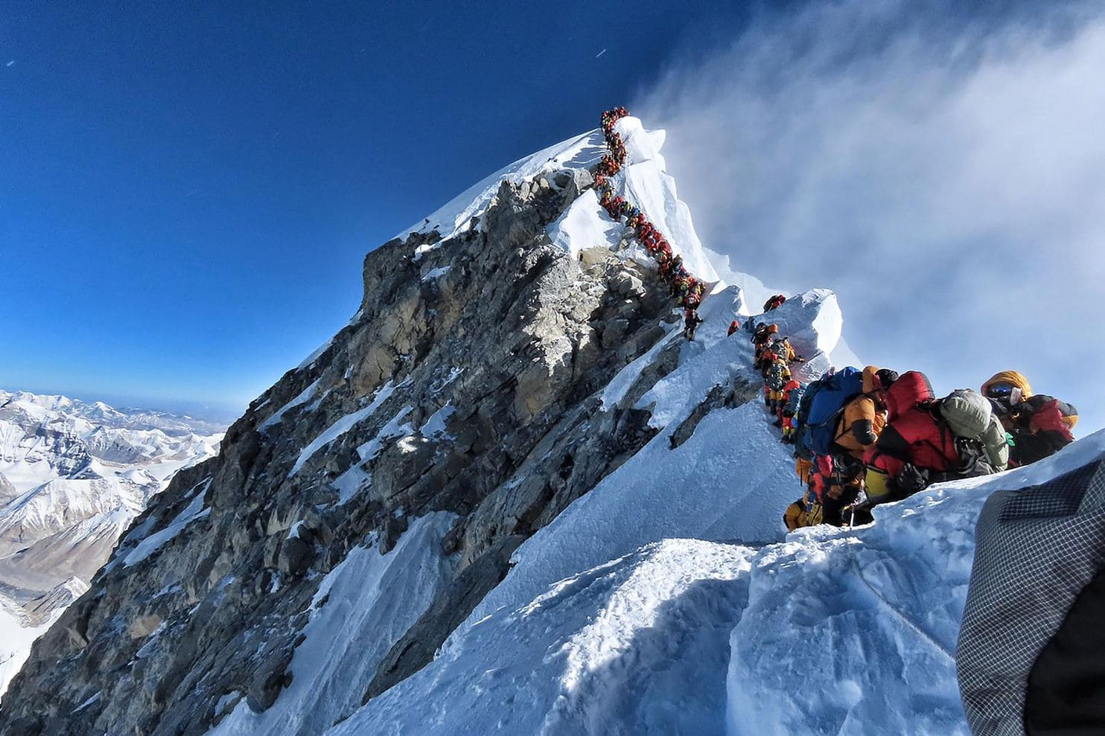
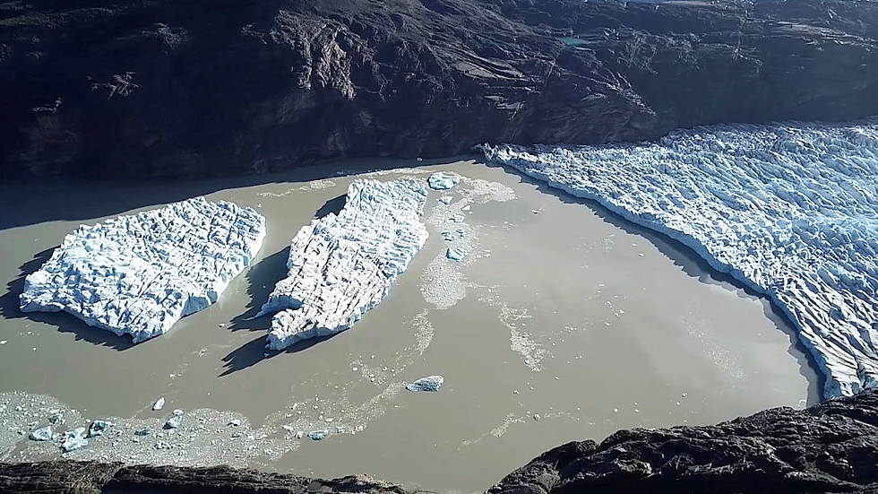
Headlines in Hungarian press in the last 7 days
„Kettétört a patagóniai jégmező a klímaváltozás miatt”
„Egyre szennyezettebb és melegebb a világ teteje”
„Magasabb lesz Újdelhi szeméthegye, mint a Taj Mahal”
„Eszement sebességgel irtják az amazonasi esőerdőket”
„Magyarországon nem hirdetnek klímavészhelyzetet”
„Kína és India komoly faültetési programokat hajtott végre”
„Faültetésre kötelezték a végzős diákokat a Fülöp-szigeteken”
Patagonian Ice Sheet ruptured
Crowd on Mount Everest

Slide 7
Quite depressing, isn’t it?
We’ve known about climate change for 30 years but we haven’t done anything. Simply because WE DON’T CARE
Scientists say we have 10-20 years to take action before it’s too late
„We do need hope. But the one thing we need more than hope is ACTION. Instead of looking for hope, look for action! Then and only then, hope will come.”
(Greta Thunberg, 16-year-old Swedish activist)

Slide 8
Solutions – that need YOUR actions too!
USE LESS water, electricity, plastic
RECYCLE whenever you can
SHOP LOCAL
BYOB – Bring Your Own Bottle everywhere
COMPOST
CHOOSE REUSABLE PRODUCTS
DON’T LITTER
CHOOSE ENVIRONMENTALLY FRIENDLY PRODUCTS
Look for these symbols on products if you want to be eco-friendly

Slide 9
This week we…
watched the latest BBC documentary on climate change
calculated our carbon footprint (ours was smaller than the Hungarian average)
did a survey in LKG on how „green” we are
checked NASA’s website to see satellite images
watched Greta Thunberg’s speech in TED Talk
on Thursday Veszprémi Dóri saved a dog in Seregélyes ☺
No one is too small to make a difference

Slide 10
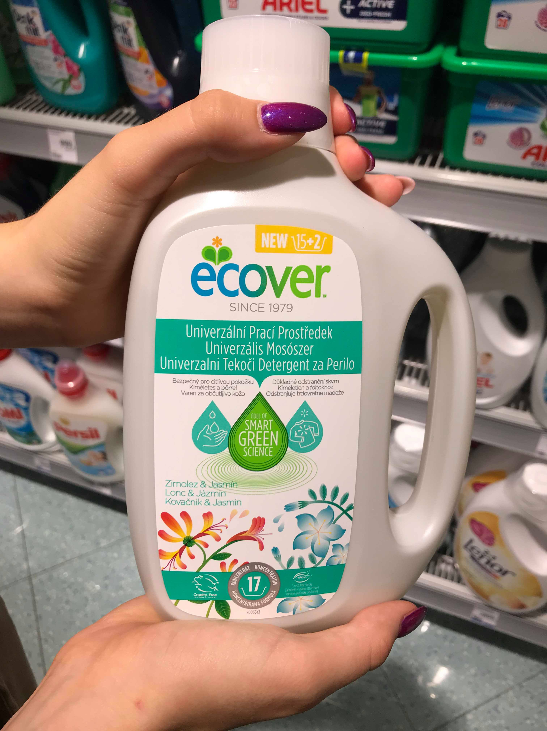
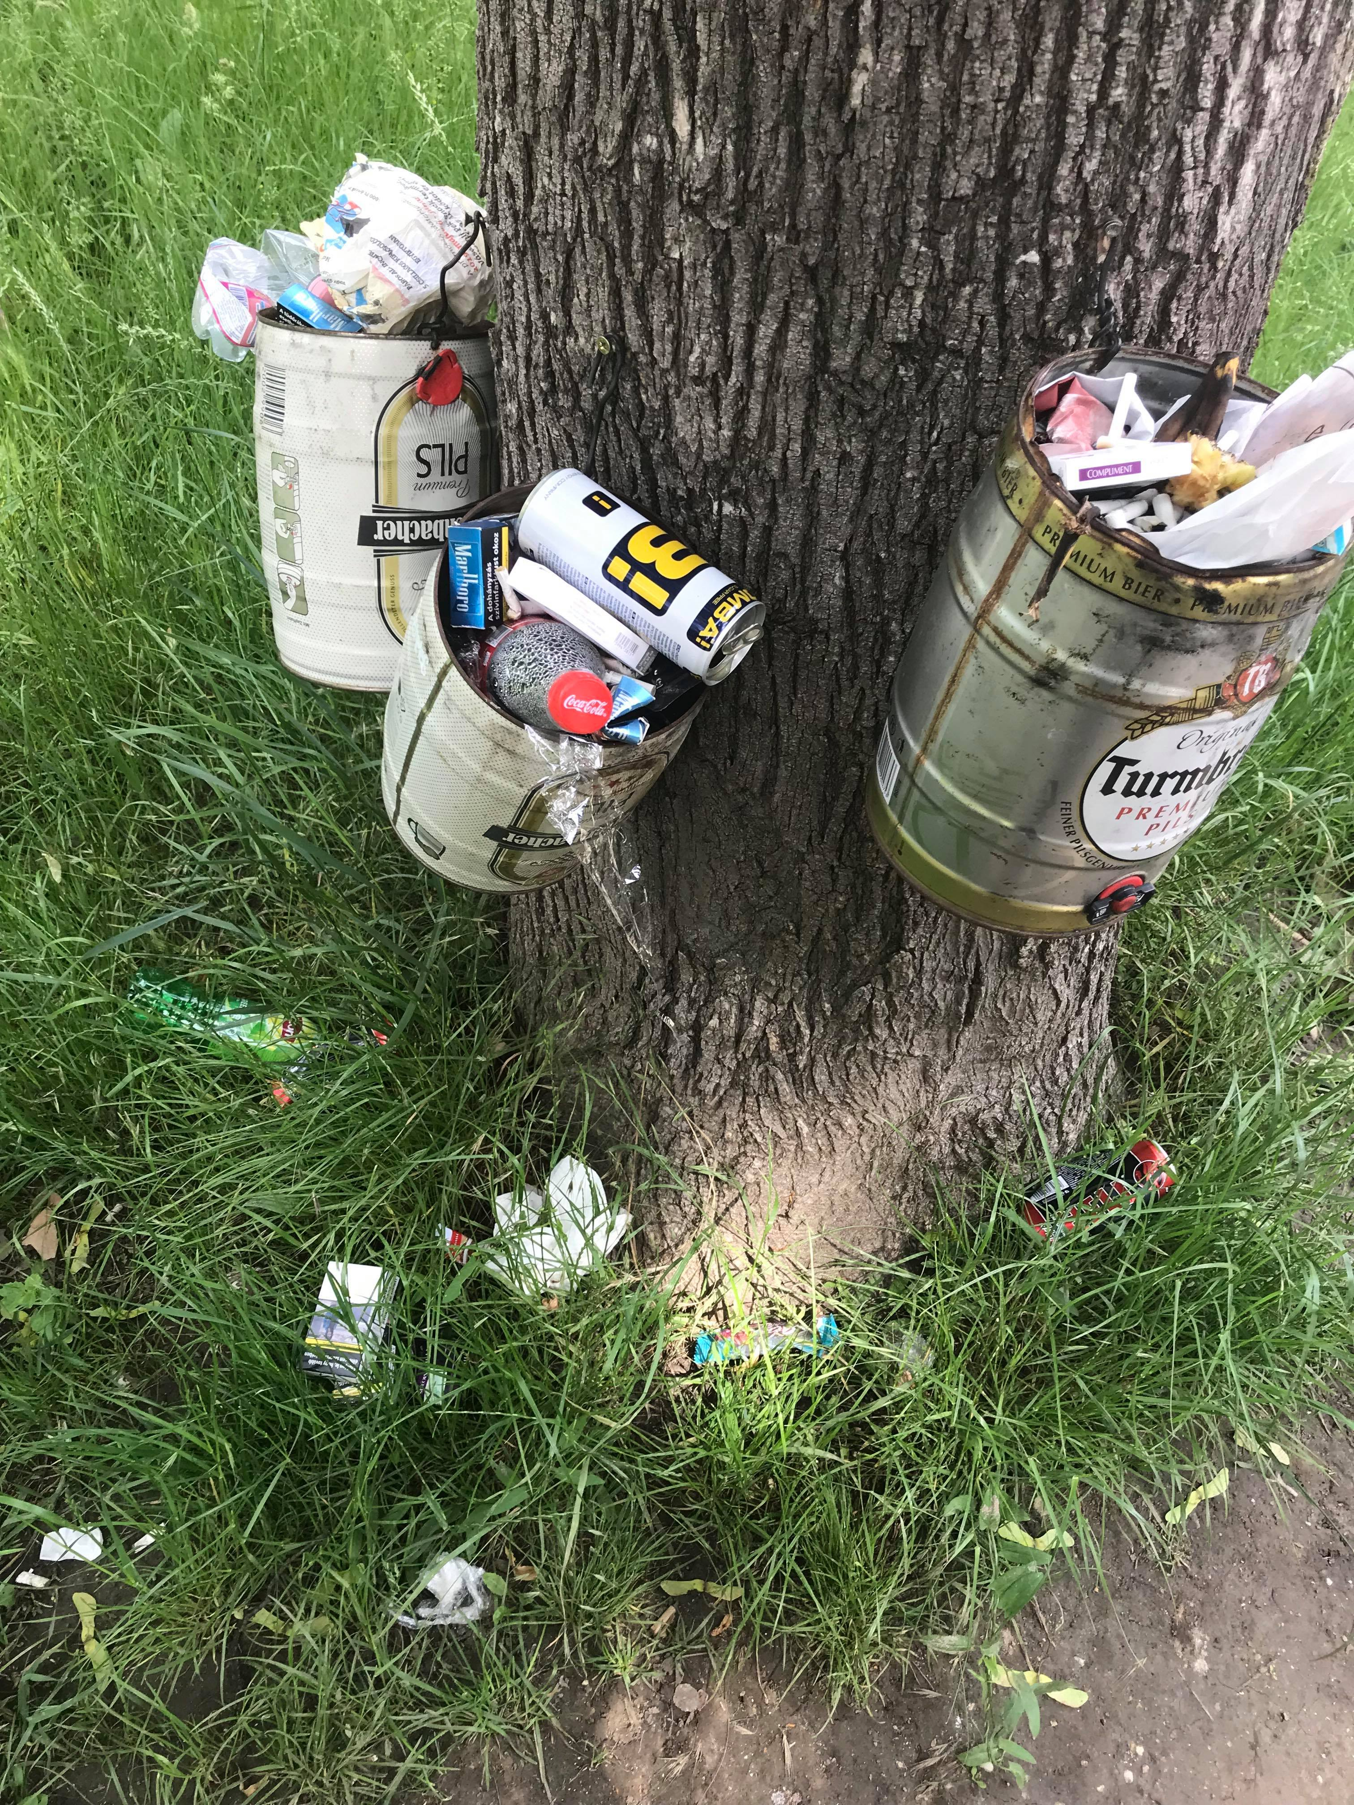
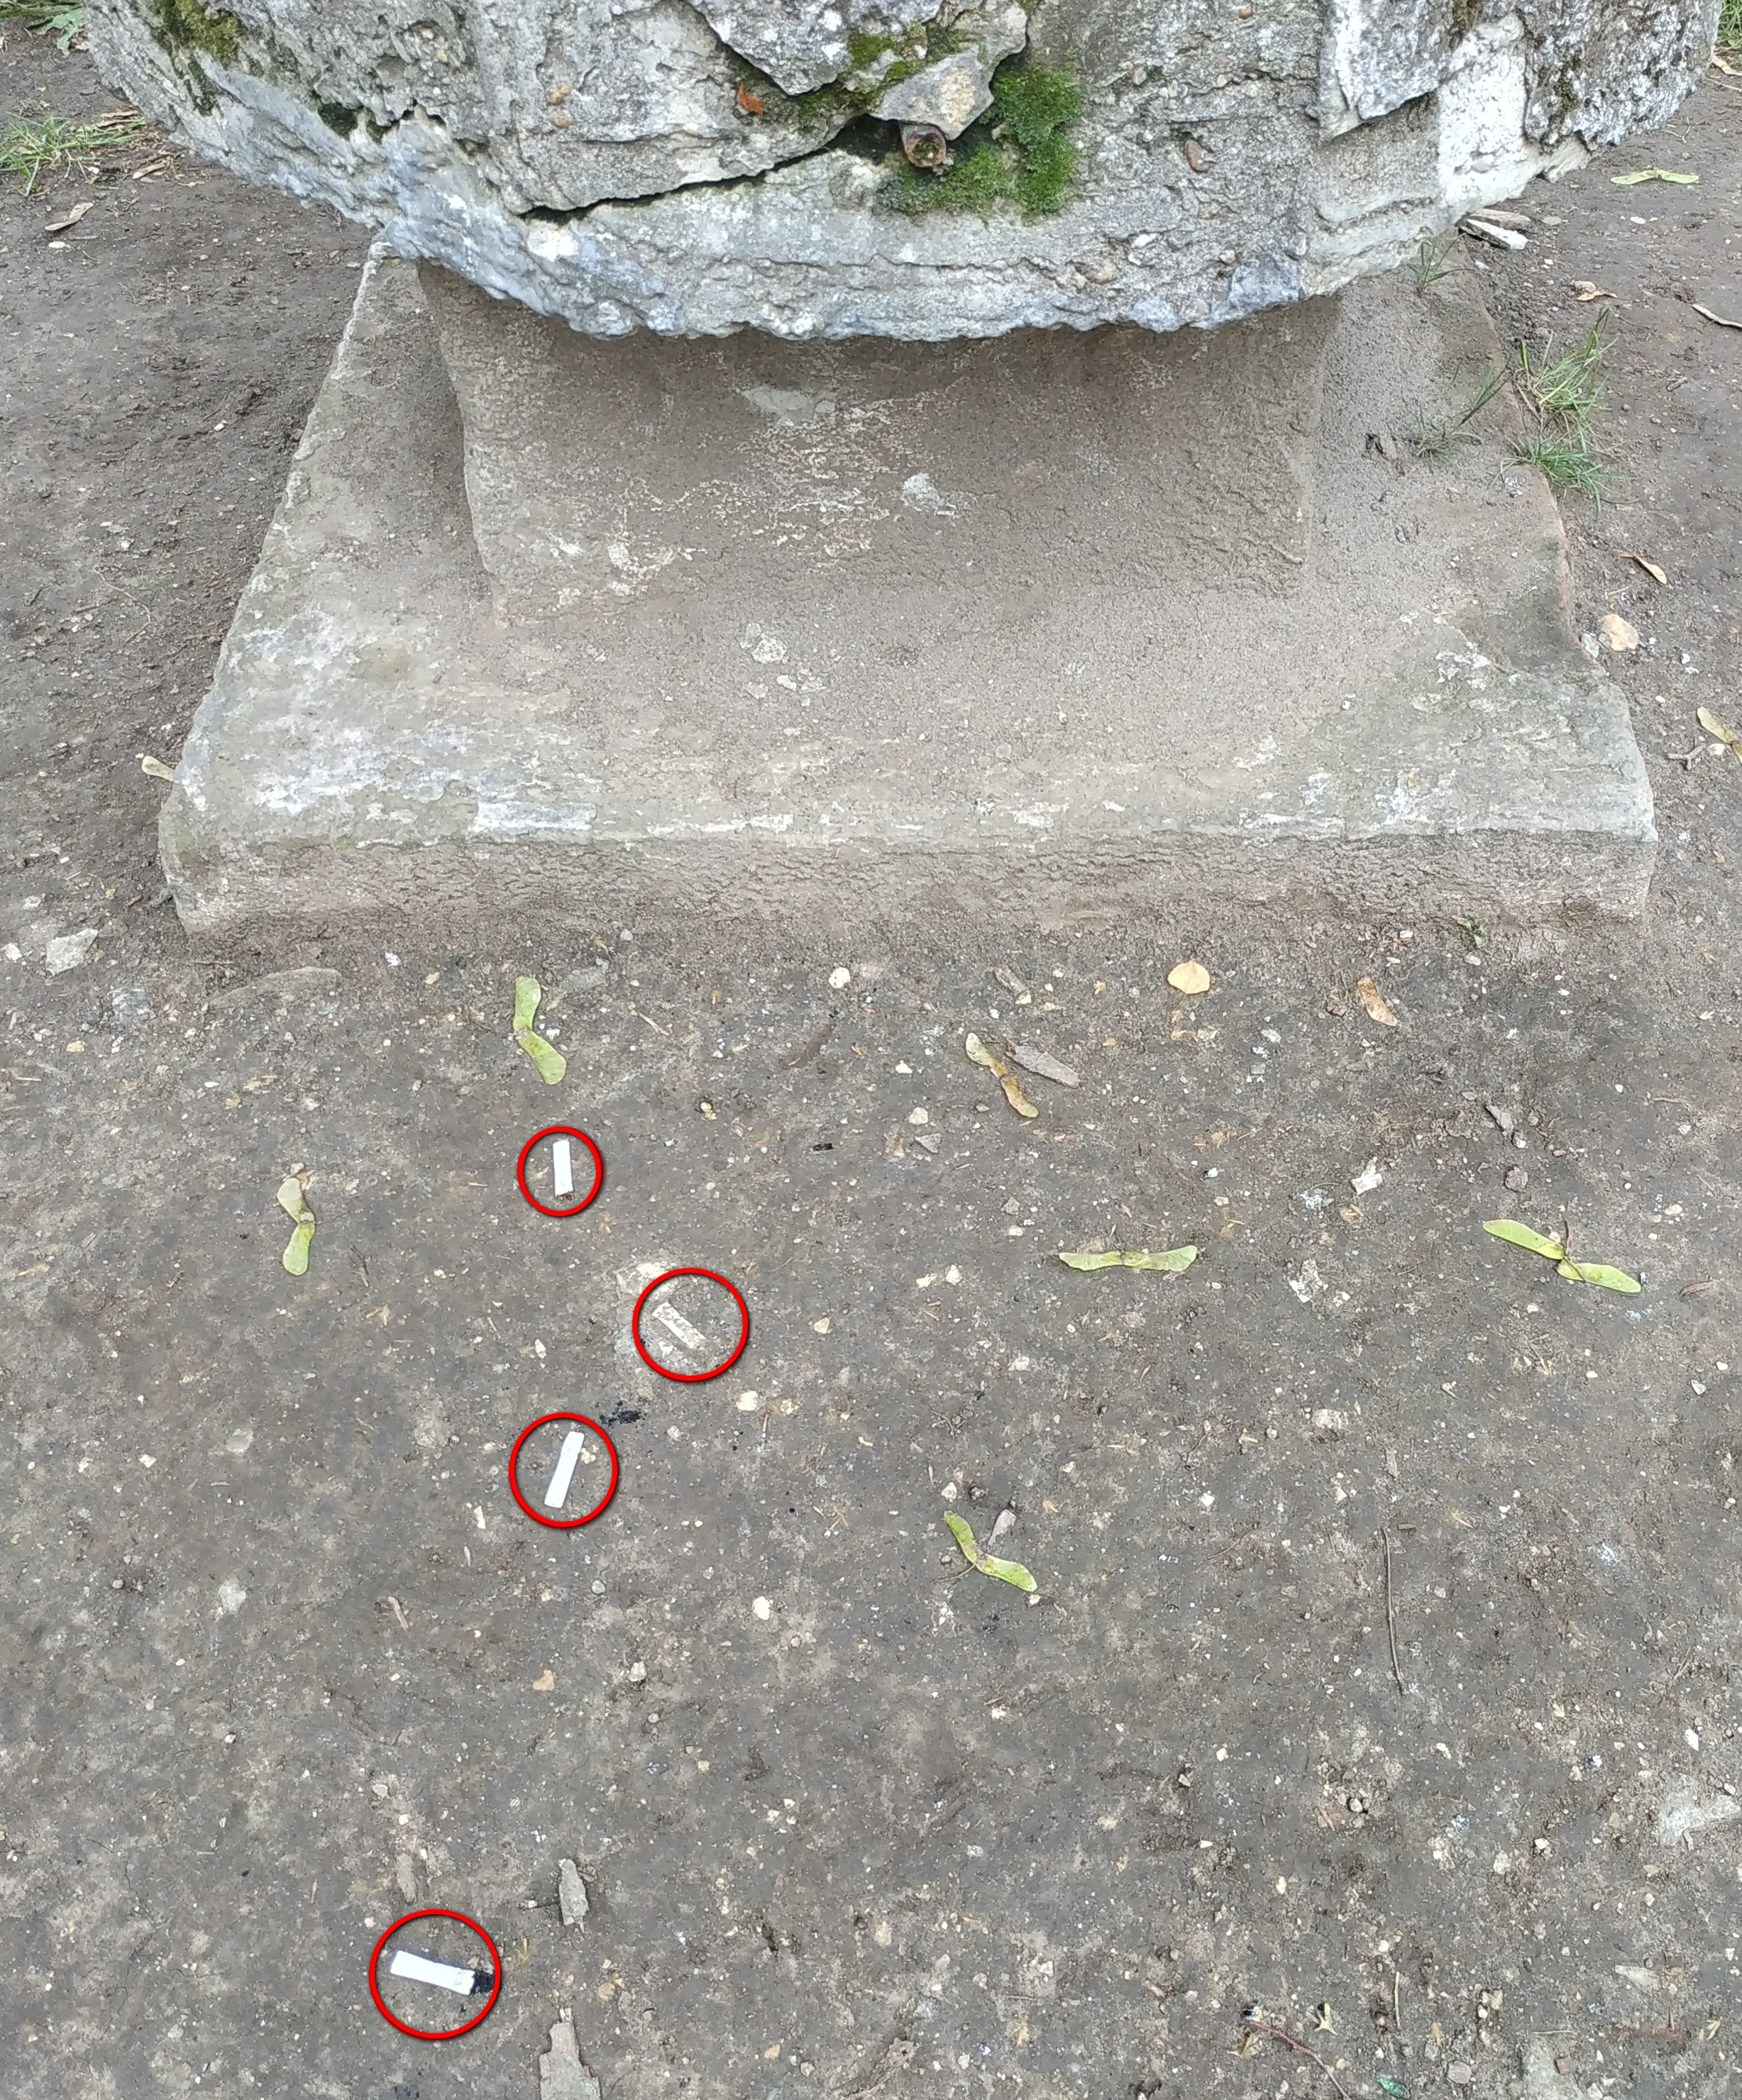
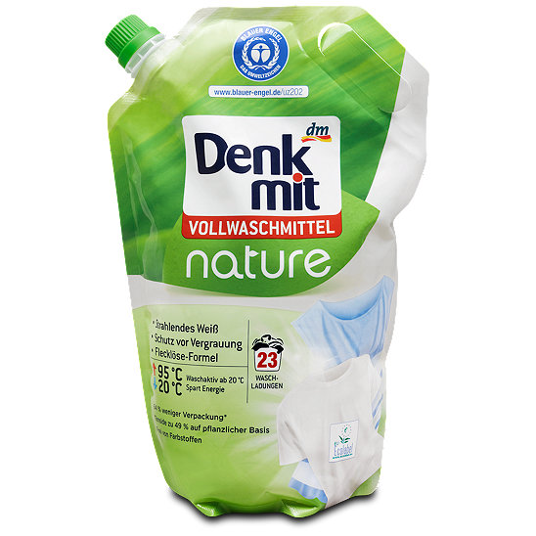
We looked for environmentally friendly products in Interspar and DM
and we picked up (y)our trash around the school
before
after
24 hours later

Slide 11
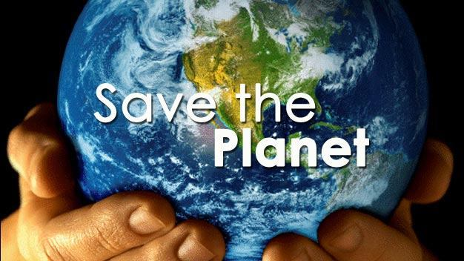
SAVE YOUR OWN FUTURE
IT’S IN YOUR HANDS

Slide 12
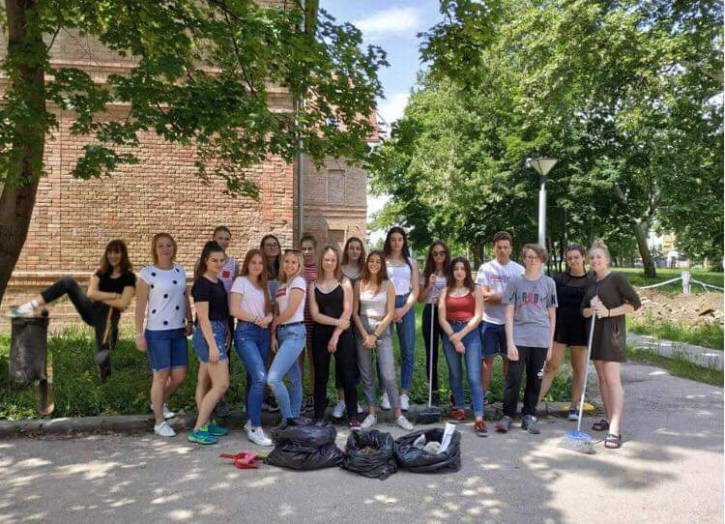
Creators:
Buza Bálint
Faragó Dorina
Fonai Dorka
Havrán Mietta
Horváth Lili
Horváth Zsombor
Joanelli Kamilla
Kiss Anna
Kiss Viktória
Kiss Virág
Körtélyesi Gréta
Lévai Virág
Lukács Janka
Malkovits Fanni
Pallag Dóra
Polacsek Hanna
Tibor Vivien
Veszprémi Dorka
Juhász Judit tanárnő THANKS FOR WATCHING ☺

